Slide 1
Trackmate
Luigi Zuccarelli
Sept 2020
Notes:
The slides below contain guidance on using PowerPoint and slide deck content. Delete these slides when you’re ready to get started.

Slide 2
Agenda
What is Trackmate ?
How is it used ?
Who will use it ?
Our Team
Sprint0 - Discovery - DevOps culture & best practises
Canned Demo (time permitting)

Slide 3
Our Team
PO
SM
FE
BE
UI/UX
Architect

Slide 4
What is Trackmate ?
Event capturing system
Another GA ?
GDPR/CCPA
Scalable marketing campaigns
Promo code - less
High volume throughput
Analytics (near real time)

Slide 5
High Level Overview
3 Main parts
SDK (vanilla js)
Data Capture
Analytics

Slide 6
Architecture Requirements
Cloud based
No vendor lock in
Cloud provider agnostic
Loosely coupled
Event driven microservices
Linux containers
High availability
Scalable

Slide 7
Client Requirements
Restful API endpoints
Analytics
AI (Spark streaming)
Dashboard
Adapters

Slide 8
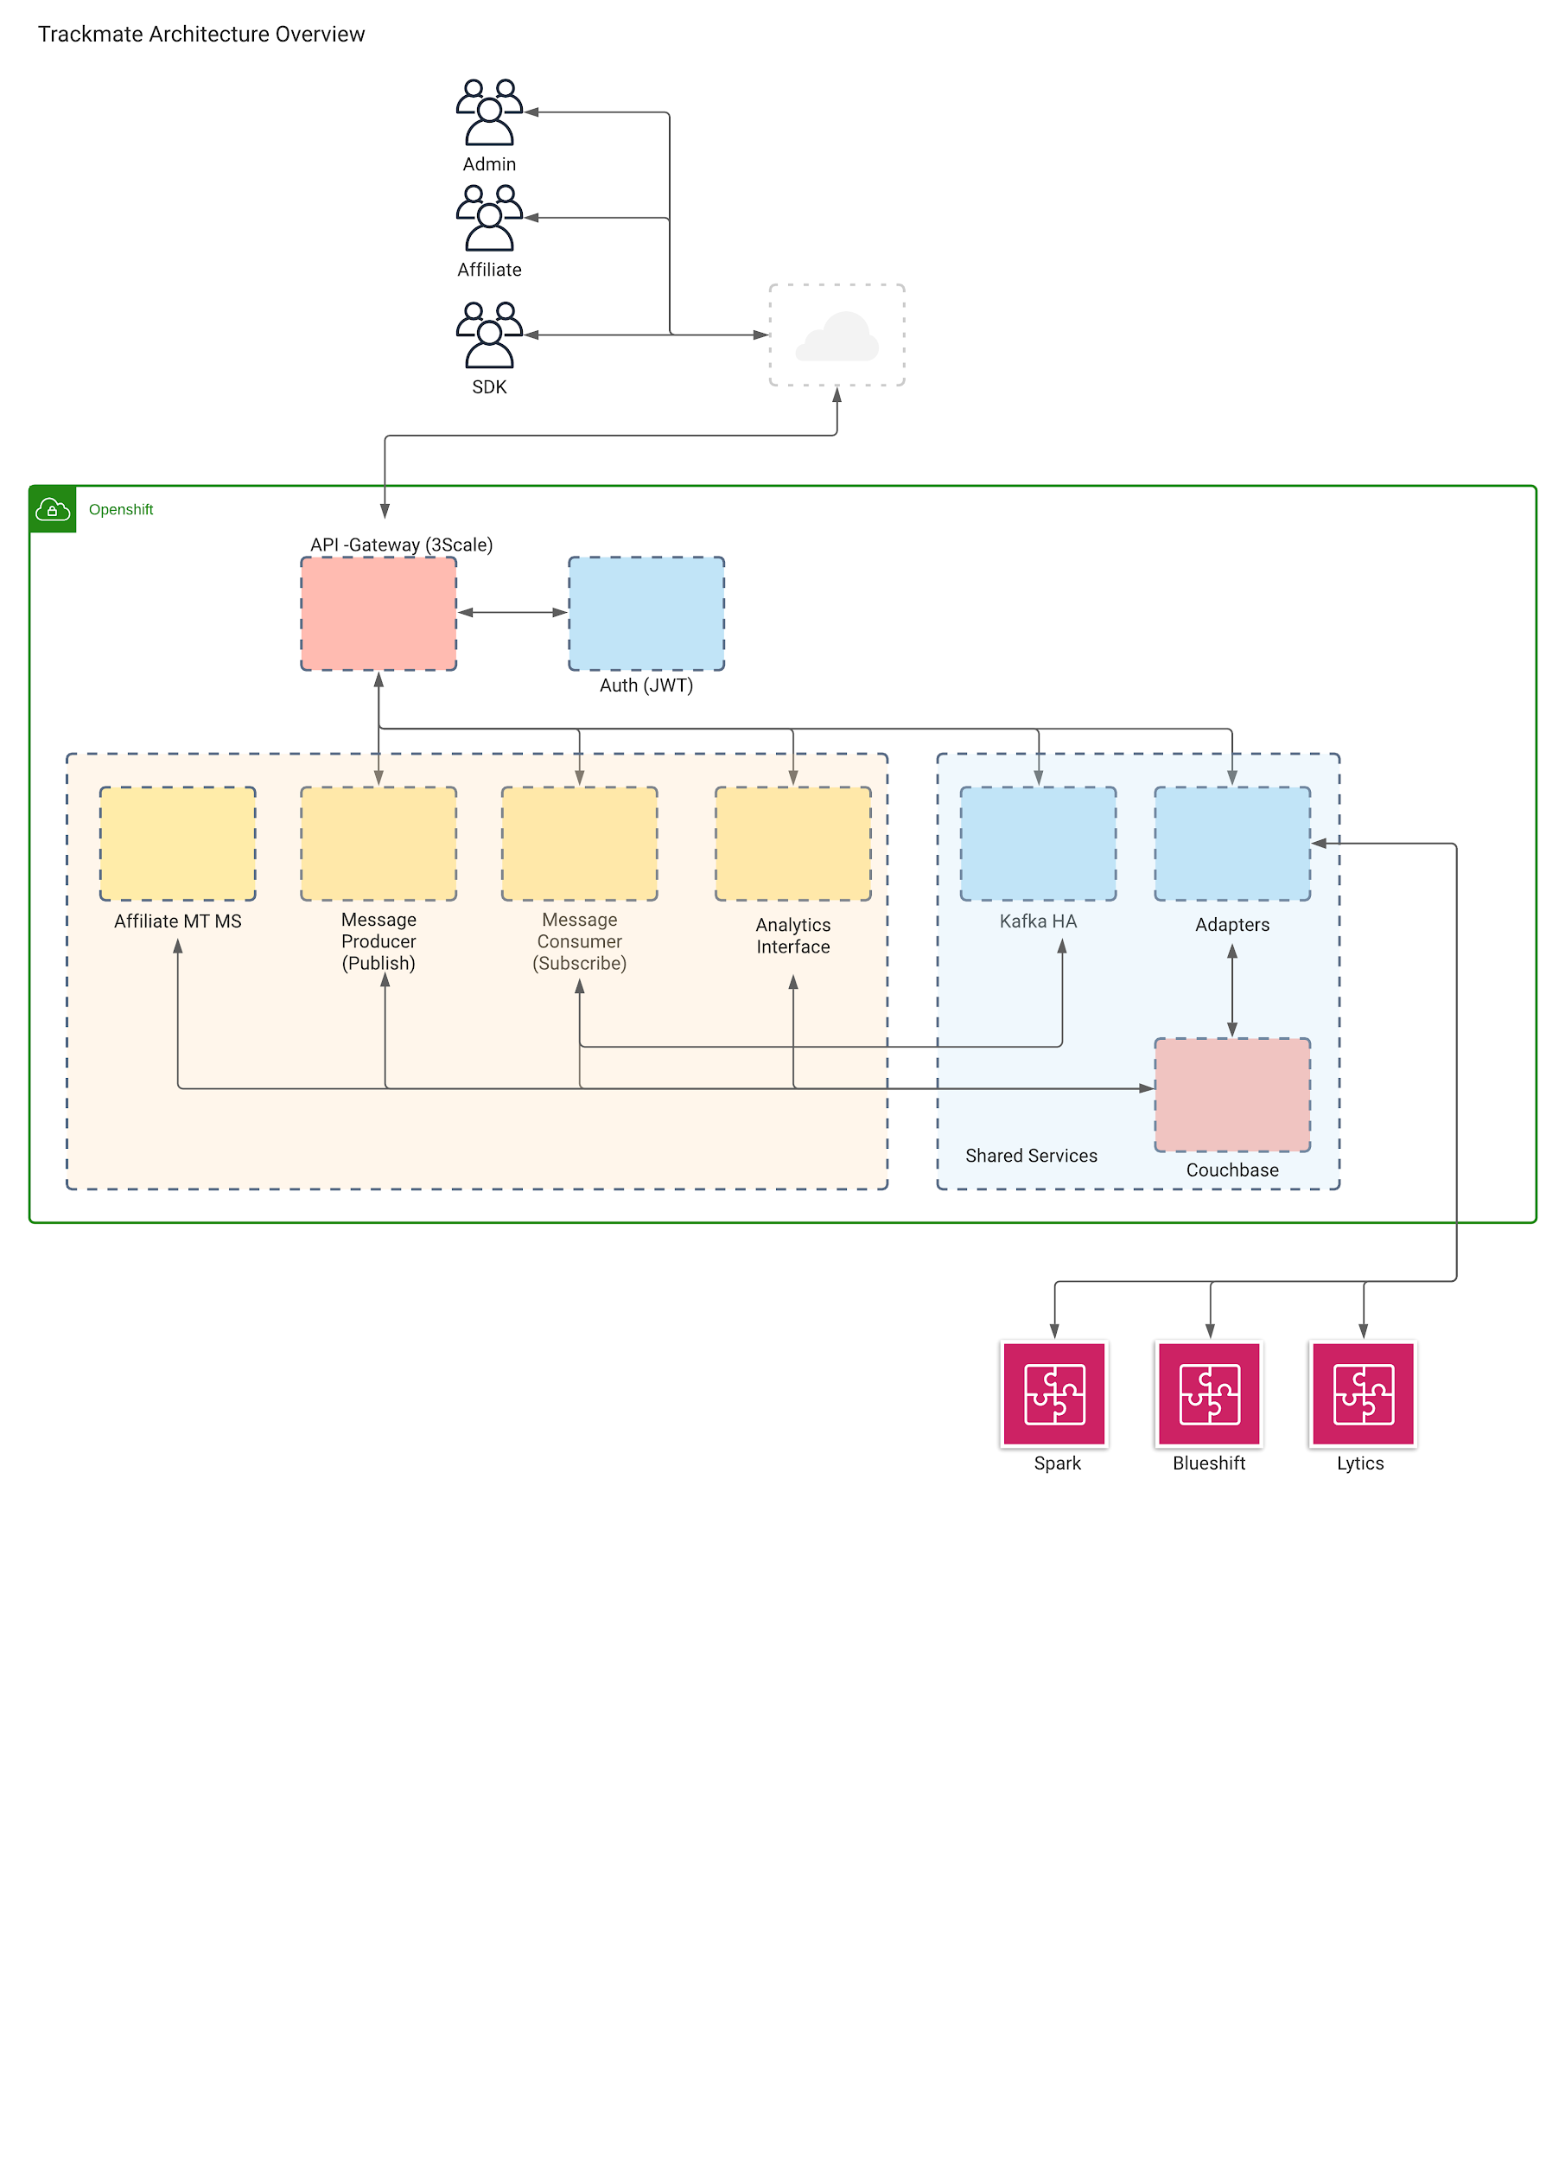
Architecture tech stack
Openshift (enterprise kubernetes)
Kafka (message queue)
Couchbase (nosql db)
Vuejs (fe)
Golang (be)
Argocd Tekton (cicd)

Slide 9
Who & How
Notes:
Any affiliate, Any web site
Embed SDK
Add utm_variables
Test

Slide 10
Sprint 0
Discovery Session
DevOps Culture & Best Practises
5th-8th May
Notes:
Any affiliate, Any web site
Embed SDK
Add utm_variables
Test

Slide 11
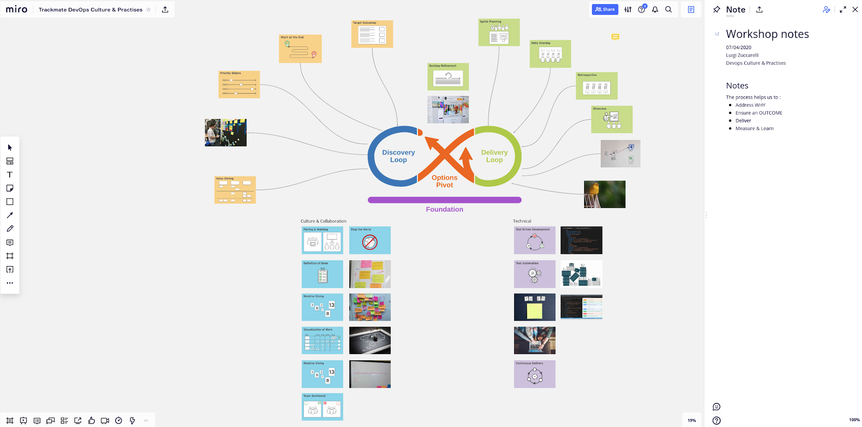

Slide 12
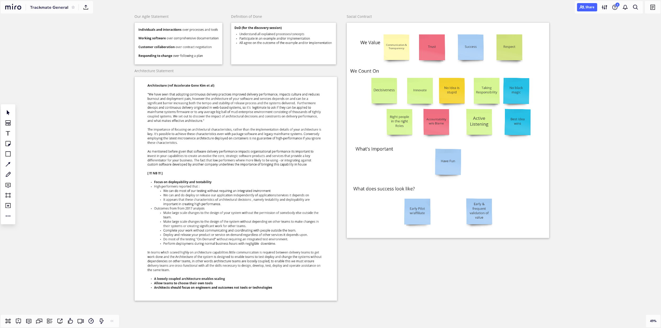

Slide 13
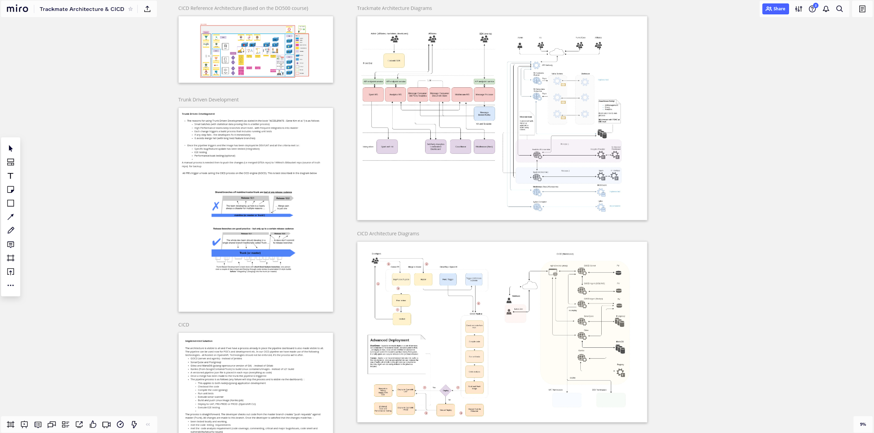

Slide 14
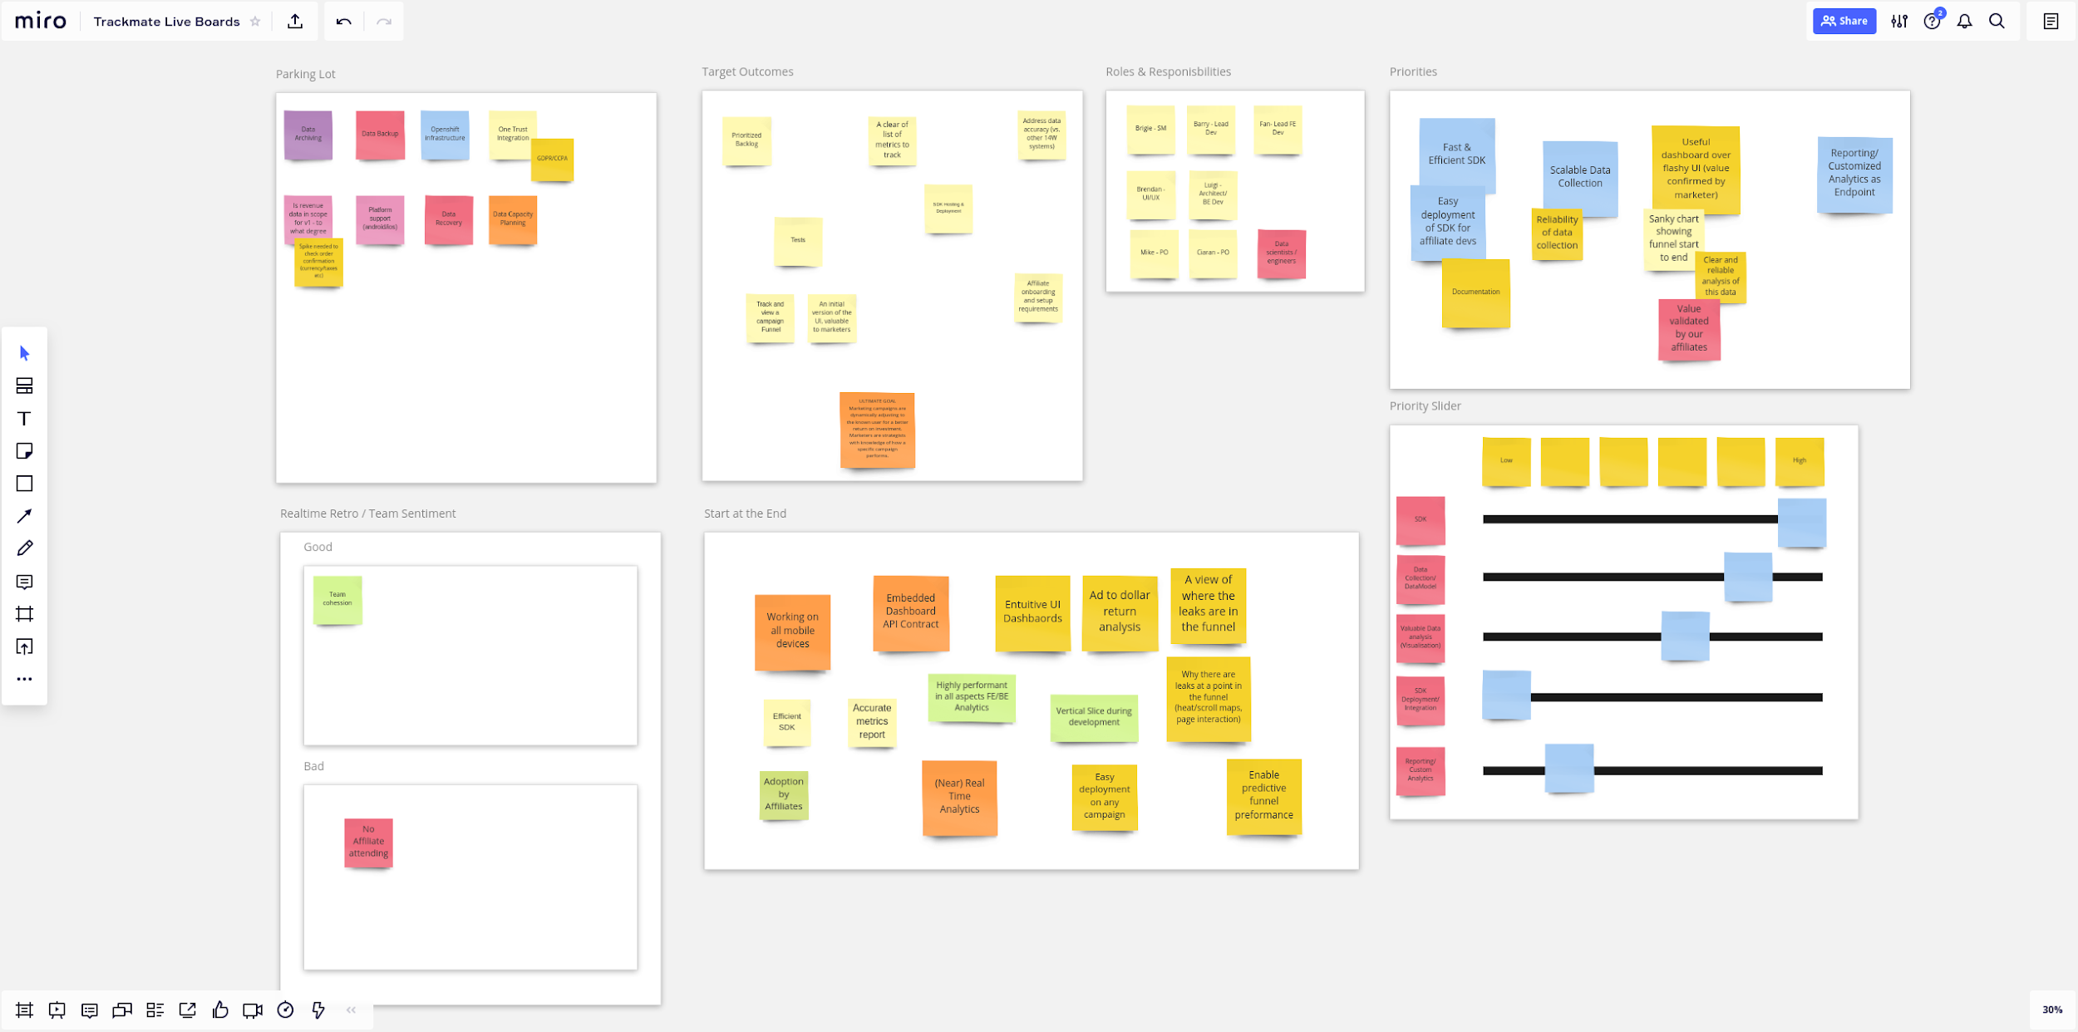

Slide 15
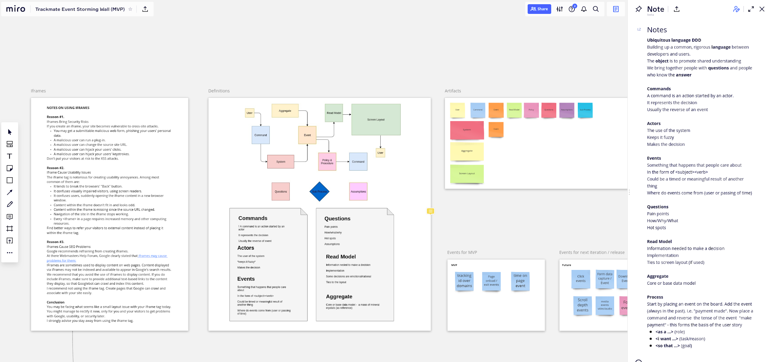

Slide 16
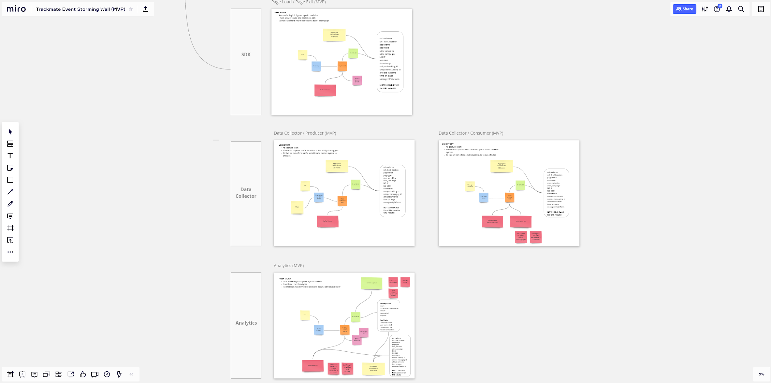

Slide 17
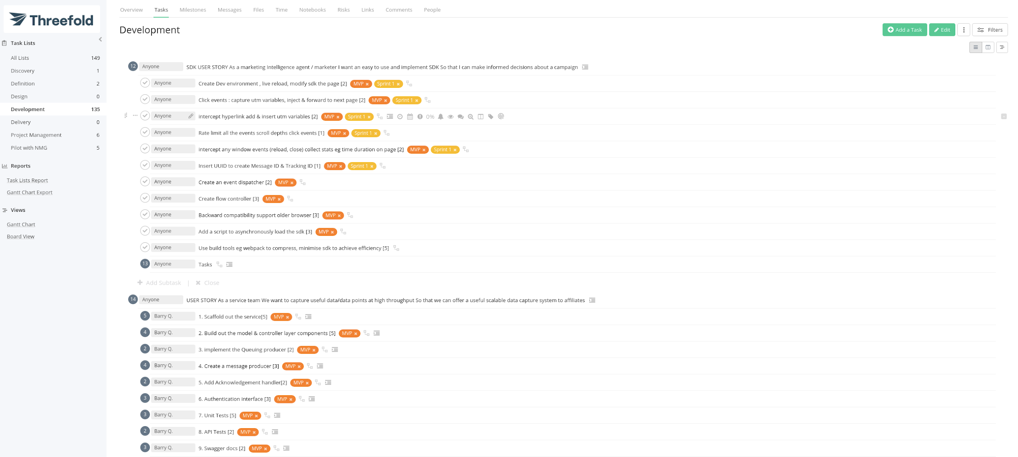

Slide 18
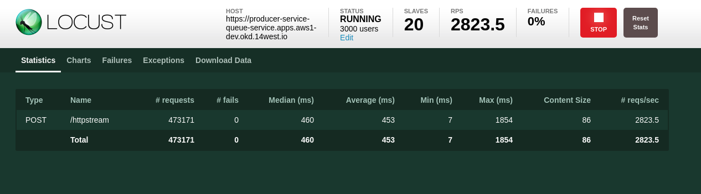
Architecture - POC
Notes:
Context
24 hrs - 241 920 000 requests
Restricted by internal F5 LB - scale to triple that
Twitter currently handle 7000+ RPS - 604 800 000
2010 - 4K-6K servers

Slide 19
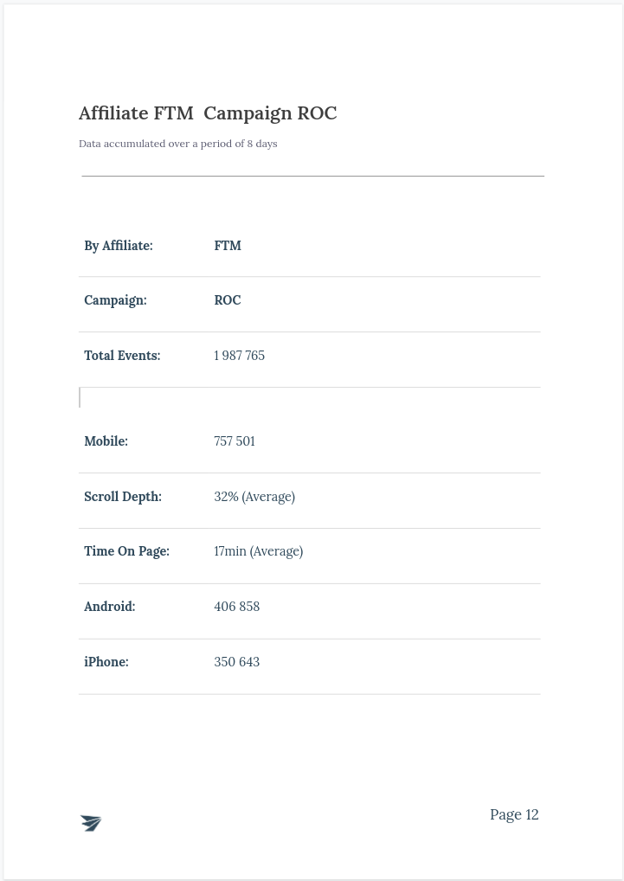
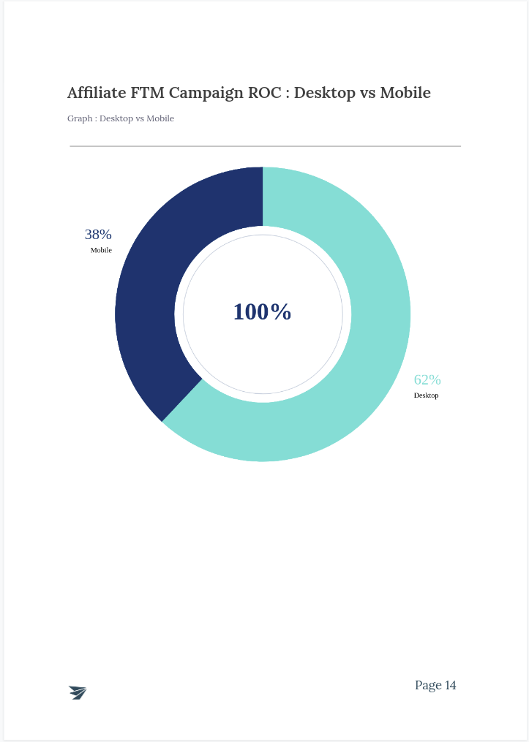
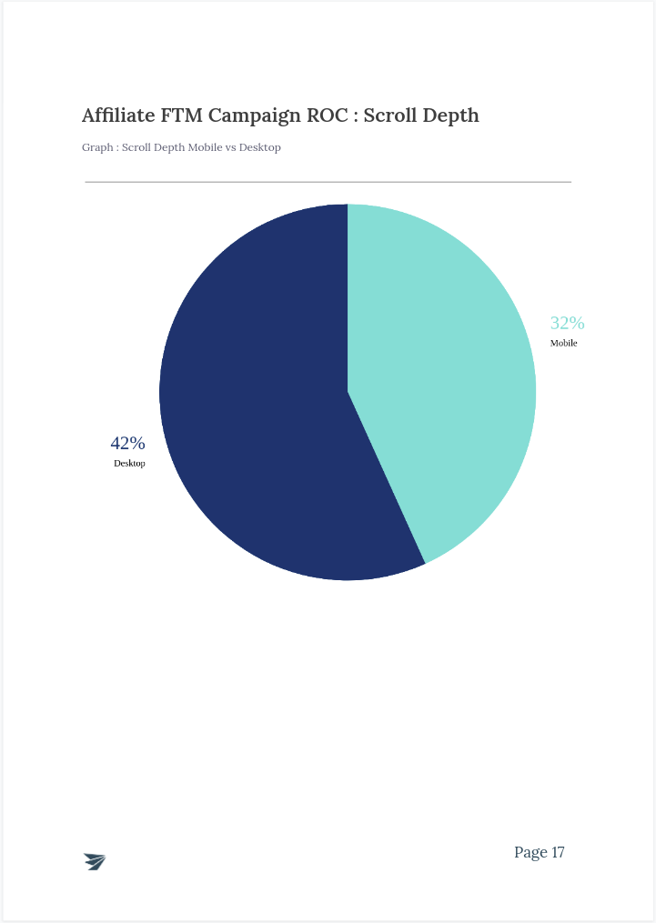
POC - Results & feedback

Slide 20

Demo overview
Tools
flow designer (simulate funnel)
flow deployer (cms and linker)
Dashboard
Demo pages
Platform (Openshift)
CICD
Code Analysis

Slide 21
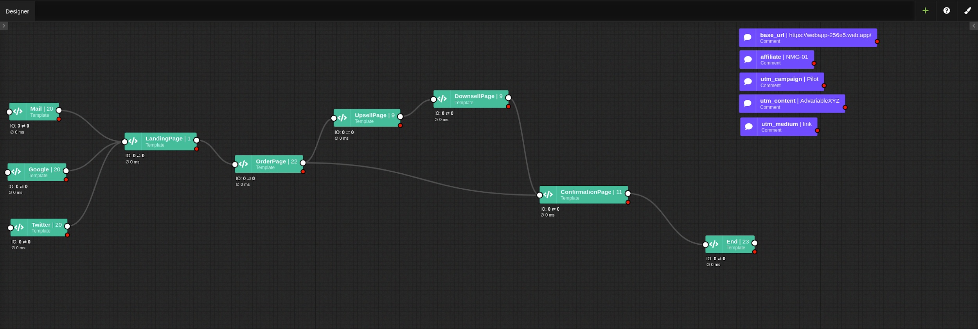

Slide 22
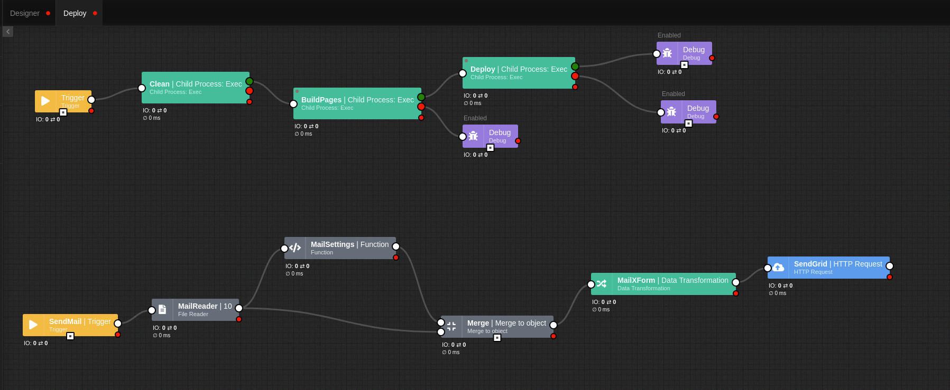

Slide 23
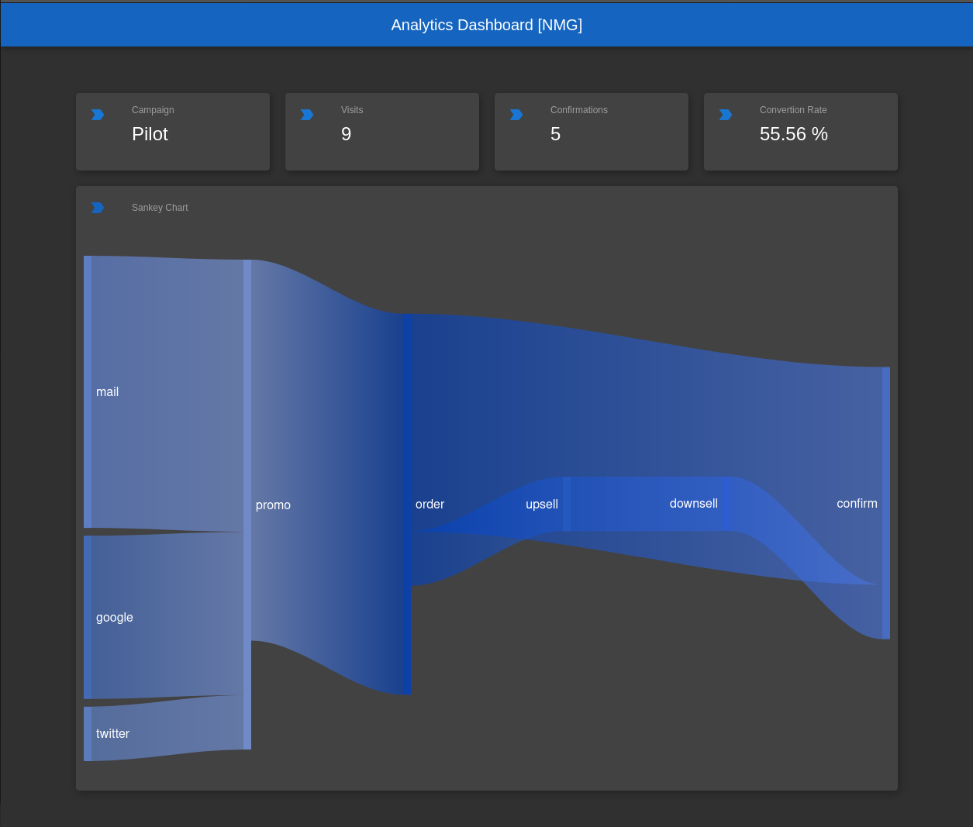

Slide 24
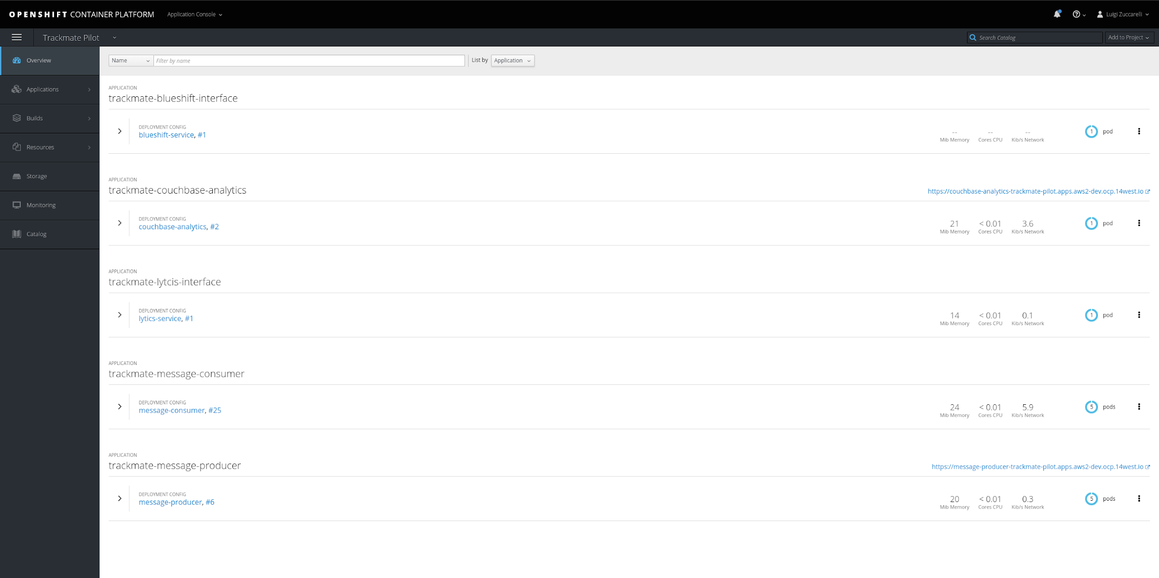

Slide 25
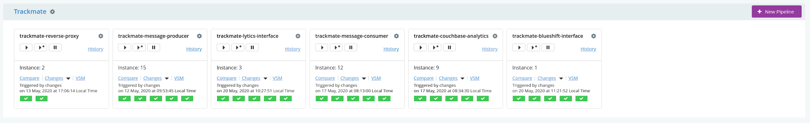

Slide 26
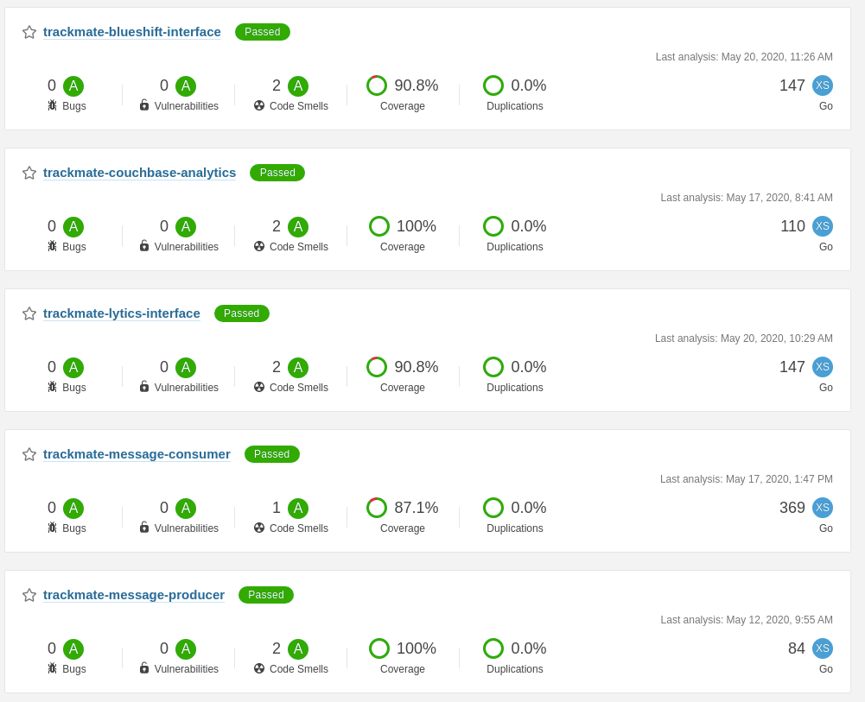

Slide 27
Next Step
Pilot with NMG on a live campaign

Slide 28

Q&A

Slide 29
Thank you

